Slide 1
React Hook

Slide 2
Objectives
Describe about Hooks
What are Hooks?
Why use Hooks?
Rule of Hooks
Describe about Built-in Hooks, Custom Hooks
Using State Hook
Using Effect Hook
Sharing data using context Hooks
Using reducer Hooks
Using Custom Hook

Slide 3
What are Hooks?
Hooks are special functions in React (introduced in version 16.8) that let you "hook into" React features like state and lifecycle methods from functional components, without needing class components. They make it easier to manage state, handle side effects, and reuse logic in a concise, functional way.
Hooks are functions that are part of the React library.
Hooks let you use different React features from your components.
You can either use the built-in Hooks or combine them to build your own.
Functions starting with use are called Hooks.

Slide 4
Why use Hooks?
Hooks allow you to augment a component with React features.
Cleaner Code: Hooks like useState and useEffect reduce boilerplate, making code more concise and readable compared to class methods like setState or componentDidMount.
Functional Components: They enable complex logic in functional components, avoiding the complexity of class syntax and this binding issues.
Reusability: Custom Hooks allow you to extract and reuse logic across components, promoting modularity without higher-order components or render props.
Simplified State Management: useState and useReducer provide intuitive ways to handle state, while useContext simplifies accessing global data without prop drilling.
Better Side-Effect Handling: useEffect consolidates lifecycle methods (mount, update, unmount) into a single API, making side effects like API calls or subscriptions easier to manage.
Improved Performance: Hooks encourage functional patterns, reducing unnecessary re-renders and enabling optimizations like useMemo and useCallback.
Easier Testing: Functional components with Hooks are stateless and predictable, simplifying unit tests compared to class components with internal state.

Slide 5
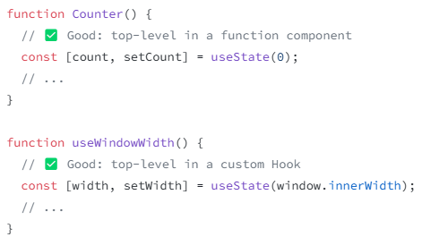
Rules of Hooks - Only call Hooks at the top level
Hooks are defined using JavaScript functions, but they represent a special type of reusable UI logic with restrictions on where they can be called.
Only call Hooks at the top level
Functions whose names start with use are called Hooks in React.
Don’t call Hooks inside loops, conditions, nested functions, or try/catch/finally blocks. Instead, always use Hooks at the top level of your React function, before any early returns. You can only call Hooks while React is rendering a function component:
✅ Call them at the top level in the body of a function component.
✅ Call them at the top level in the body of a custom Hook.

Slide 6
Rules of Hooks – Only call Hooks at the top level - cont’d
It’s not supported to call Hooks (functions starting with use) in any other cases, for example:
🔴 Do not call Hooks inside conditions or loops.
🔴 Do not call Hooks after a conditional return statement.
🔴 Do not call Hooks in event handlers.
🔴 Do not call Hooks in class components.
🔴 Do not call Hooks inside functions passed to useMemo, useReducer, or useEffect.
🔴 Do not call Hooks inside try/catch/finally blocks.

Slide 7
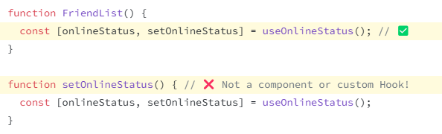
Rules of Hooks – Only call Hooks from React functions
Don’t call Hooks from regular JavaScript functions. Instead, you can:
✅ Call Hooks from React function components.
✅ Call Hooks from custom Hooks.
By following this rule, you ensure that all stateful logic in a component is clearly visible from its source code.

Slide 8
Built-in Hooks
Basic Hooks
State Hooks: useState declares a state variable that you can update directly.
Context Hooks: useContext reads and subscribes to a context.
Effect Hooks: useEffect connects a component to an external system.

Slide 9
useState
useState is a React Hook that lets you add a state variable to your component.
useState(initialState)
useState include:
Initial state values
Updating state values
useState returns an array with exactly two values:
The current state. During the first render, it will match the initialState you have passed.
The set function that lets you update the state to a different value and trigger a re-render.

Slide 10
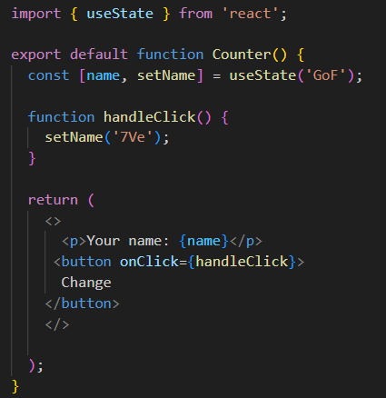


useState - Demo
Initial state value
Updating state value

Slide 11
useEffect
useEffect is a React Hook that lets you synchronize a component with an external system.
useEffect(setup, dependencies?)
The Effect Hook lets you perform side effects in function components
Sometimes, we want to run some additional code after React has updated the DOM. Network requests, manual DOM mutations, and logging are common examples of effects that don’t require a cleanup.

Slide 12
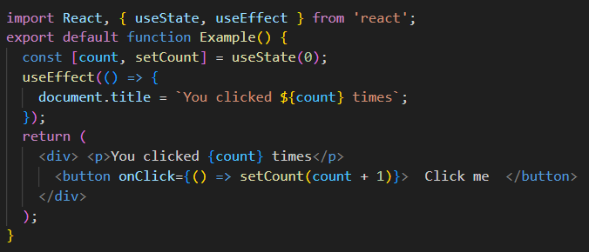
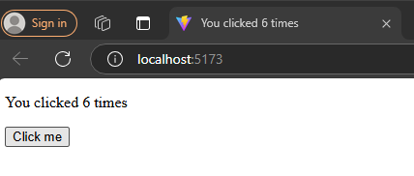
useEffect - Demo

Slide 13
useContext
useContext is a React Hook that lets you read and subscribe to context from your component.
useContext(SomeContext), SomeContext: The context that you’ve previously created with createContext
Call useContext at the top level of your component to read and subscribe to context.

Slide 14
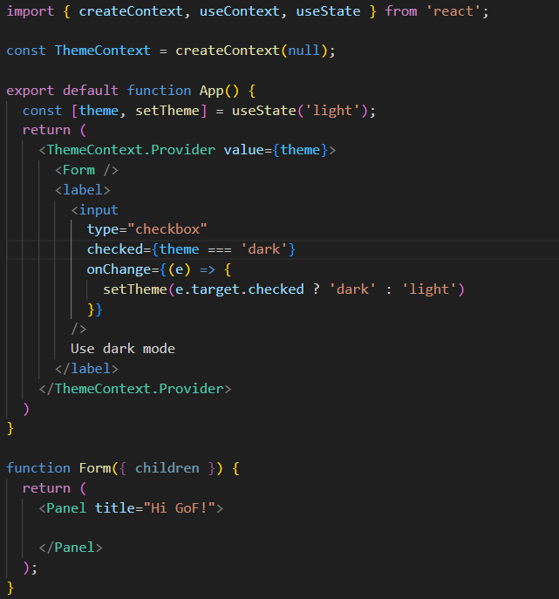
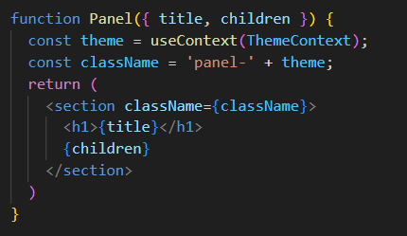
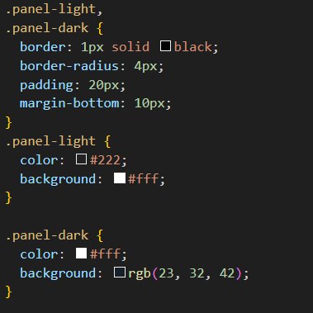
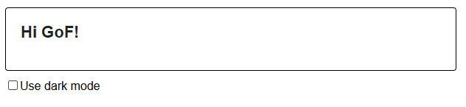
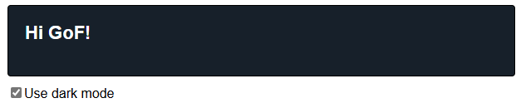
useContext - Demo
App.jsx
styles.css
App.jsx

Slide 15
useReducer
useReducer is a React Hook that lets you add a reducer to your component.
useReducer(reducer, initialArg, init?)
Call useReducer at the top level of your component to manage its state with a reducer.
The dispatch function returned by useReducer lets you update the state to a different value and trigger a re-render. You need to pass the action as the only argument to the dispatch function.

Slide 16
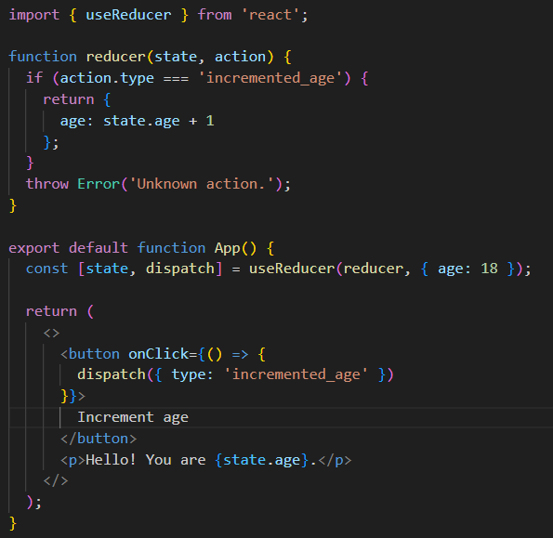

useReducer - Demo

Slide 17
Custom Hook
Hooks are reusable functions.
When you have component logic that needs to be used by multiple components, we can extract that logic to a custom Hook.
Custom Hooks start with "use". Example: useFetch.

Slide 18
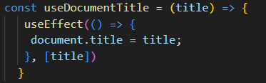
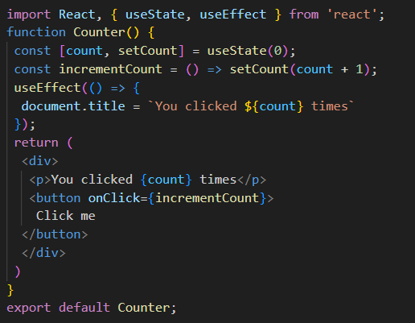
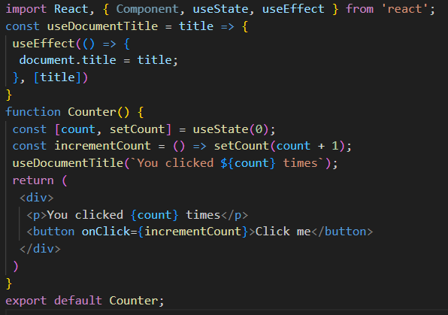
Custom Hook - Demo
Custom Hook
(useDocumentTitle)

Slide 19
Summary
Concepts were introduced:
Describe about Hooks
What are Hooks?
Why use Hooks?
Rule of Hooks
Describe about Built-in Hooks, Custom Hooks
Using State Hook
Using Effect Hook
Sharing data using context Hooks
Using reducer Hooks
Using Custom Hook

